Slide 1
Small Temperature is All You Need for Differentiable Architecture Search
Prepared by Jie Yong Shin
Advisor: Kang Dae-Ki
12th July 2023

Slide 2
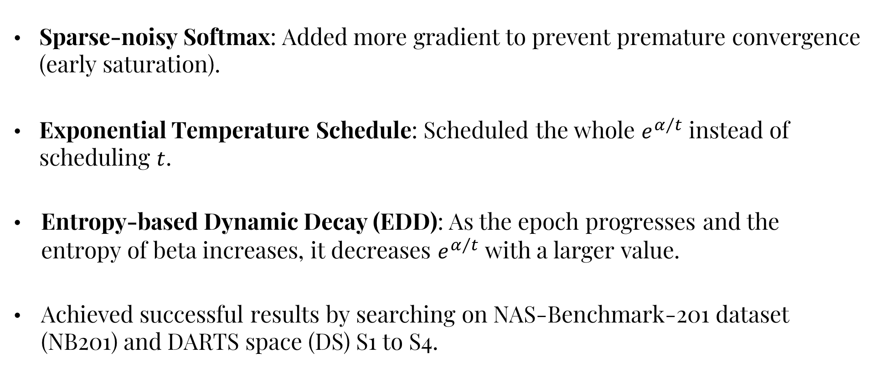
Highlights
Sparse-noisy Softmax: Added more gradient to prevent premature convergence (early saturation).
Exponential Temperature Schedule: Scheduled the whole $ⅇ^{α/t}$ instead of scheduling $t$.
Entropy-based Dynamic Decay (EDD): As the epoch progresses and the entropy of beta increases, it decreases $ⅇ^{α/t}$ with a larger value.
Achieved successful results by searching on NAS-Benchmark-201 dataset (NB201) and DARTS space (DS) S1 to S4.

Slide 3
Outline
Sparse-noisy Softmax
Exponential Temperature Schedule
Entropy-based Adaptive Scheme
Experimental Results
Conclusion
Future Works

Slide 4
Outline
Sparse-noisy Softmax
Exponential Temperature Schedule
Entropy-based Adaptive Scheme
Experimental Results
Conclusion
Future Works

Slide 5
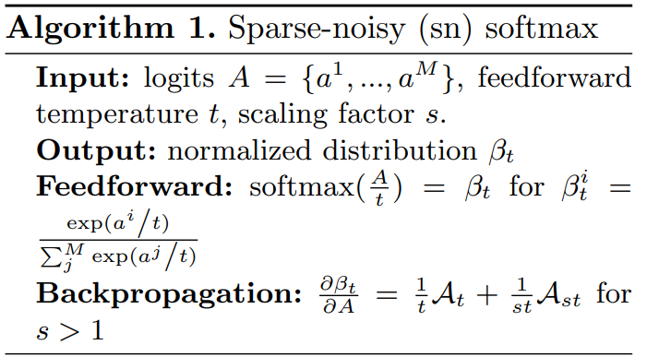
Sparse-noisy Softmax
Feedforward is exactly the same with our method.
Author have adjusted backpropagation by force.

Slide 6
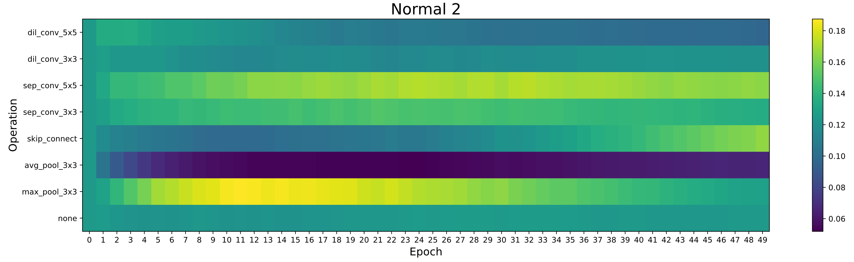
Sparse-noisy Softmax
The problem of low temperature value is, it traps every beta values to zero except one value for every vectors.
Author wanted the alpha values to be updated if the values in a vector is still similar.

Slide 7
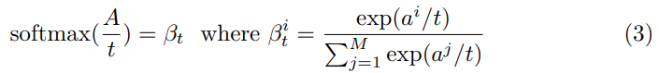
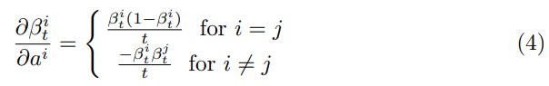
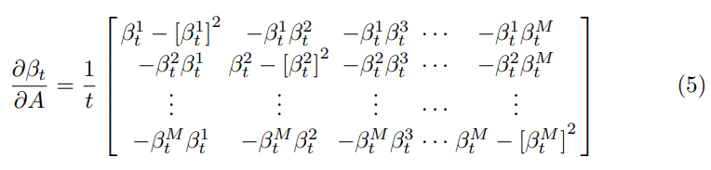
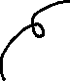
Sparse-noisy Softmax
(1)
(2)
(3)

Slide 8
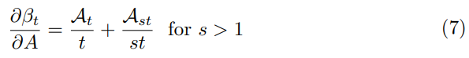
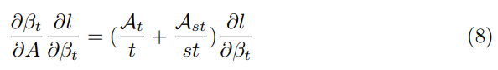

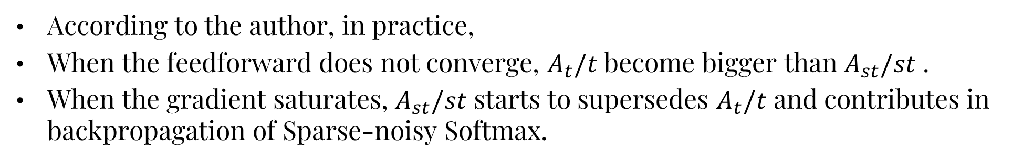
Sparse-noisy Softmax
Scaling factor
(4)
(5)
According to the author, in practice,
When the feedforward does not converge, $A_{t}/t$ become bigger than $A_{st}/st$ .
When the gradient saturates, $A_{st}/st$ starts to supersedes $A_{t}/t$ and contributes in backpropagation of Sparse-noisy Softmax.

Slide 9
Outline
Sparse-noisy Softmax
Exponential Temperature Schedule
Entropy-based Adaptive Scheme
Experimental Results
Conclusion
Future Works

Slide 10
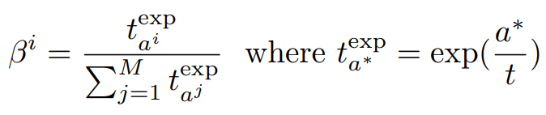
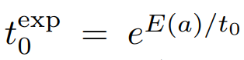
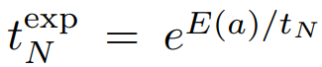
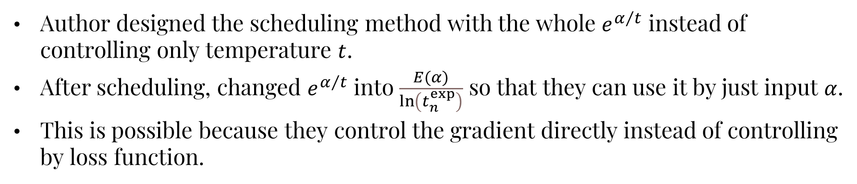
Exponential Temperature Schedule
Author designed the scheduling method with the whole $ⅇ^{α/t}$ instead of controlling only temperature $t$.
After scheduling, changed $ⅇ^{α/t}$ into $\frac{E(α)}{\ln\left(t_{n}^{exp}\right)}$ so that they can use it by just input $α$.
This is possible because they control the gradient directly instead of controlling by loss function.
(1)
i.e.)
,

Slide 11
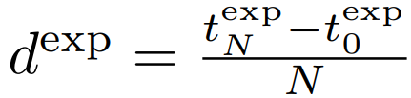
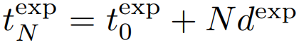
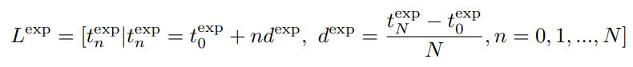
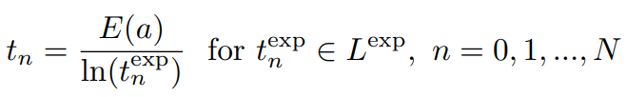
Exponential Temperature Schedule
(2)
(3)
(4)
Arithmetic sequence
(5)

Slide 12
Outline
Sparse-noisy Softmax
Exponential Temperature Schedule
Entropy-based Adaptive Scheme
Experimental Results
Conclusion
Future Works

Slide 13
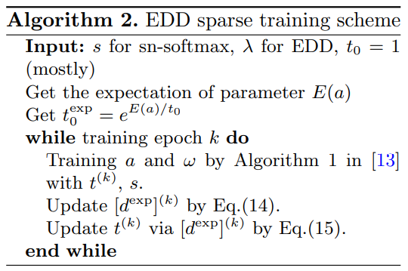
Entropy-based Adaptive Scheme
According to the Author, a fixed decay strength($d^{exp}$) is not robust in practice.
So, they design another decay method to control the decay length.

Slide 14
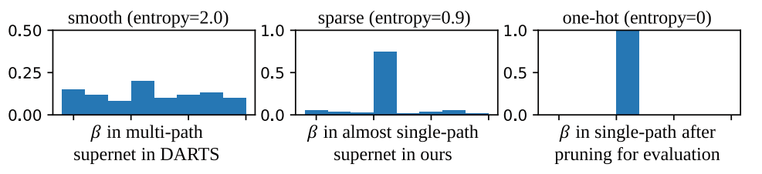
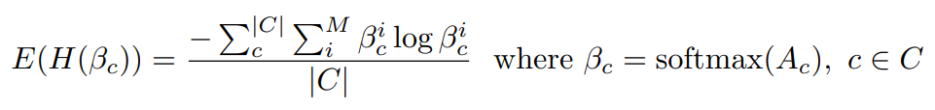


Entropy-based Adaptive Scheme
Entropy
Set of operations
(13)

Slide 15
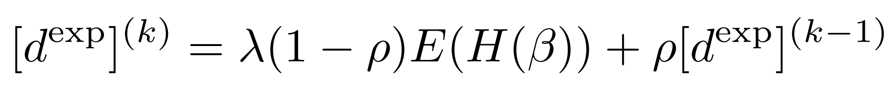
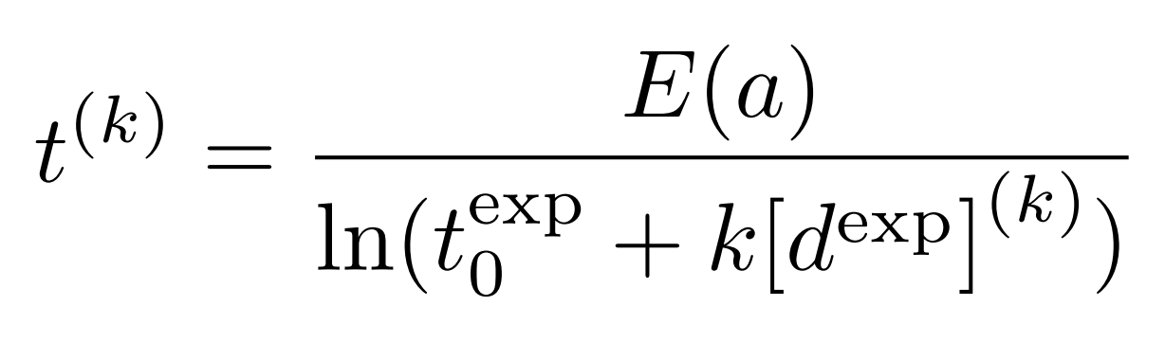
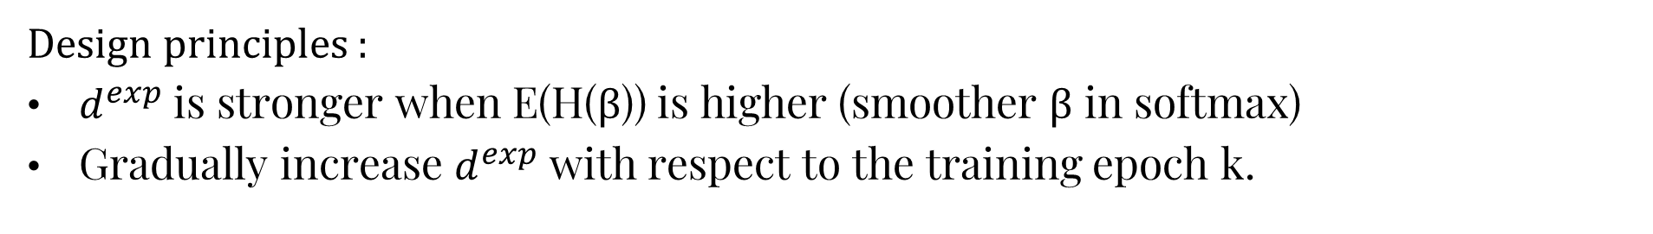


Entropy-based Adaptive Scheme
Design principles :
$d^{exp}$ is stronger when E(H(β)) is higher (smoother β in softmax)
Gradually increase $d^{exp}$ with respect to the training epoch k.
Momentum
(14)
$λ$ is a hyperparameter to determine the influence of E(H(β)) on $d^{exp}$.
(15)

Slide 16
Outline
Sparse-noisy Softmax
Exponential Temperature Schedule
Entropy-based Adaptive Scheme
Experimental Results
Conclusion
Future Works

Slide 17
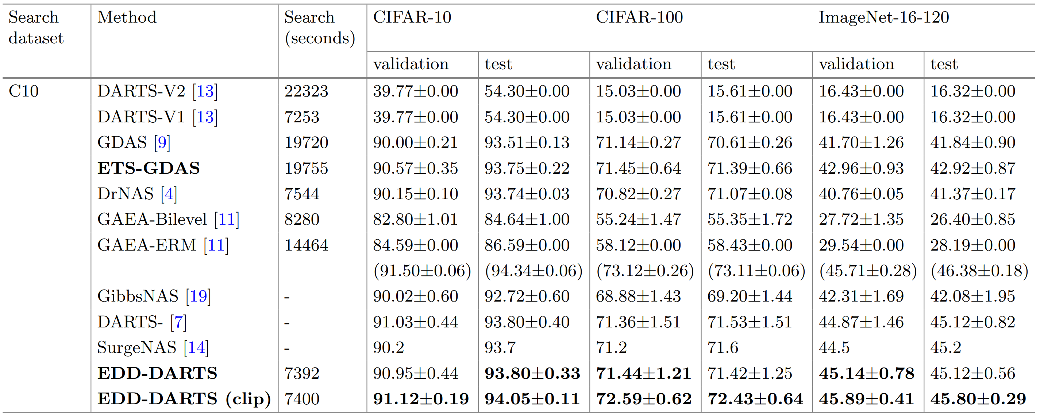
Experimental Results

Slide 18
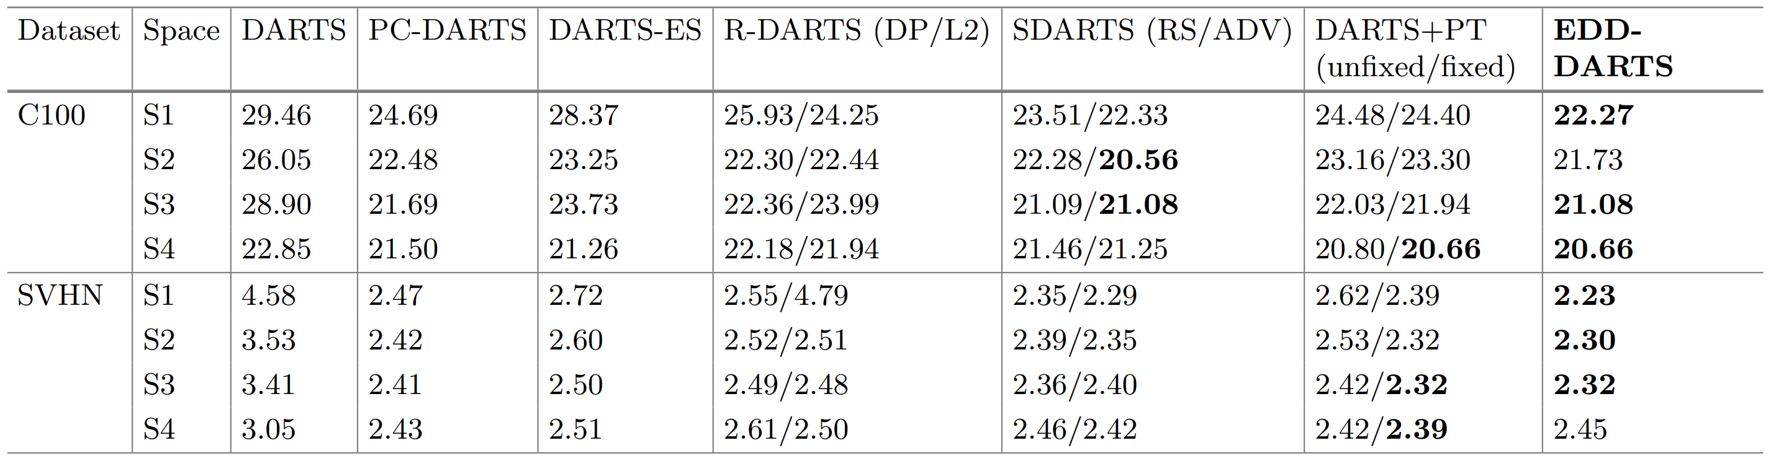
Experimental Results

Slide 19
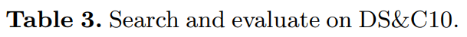
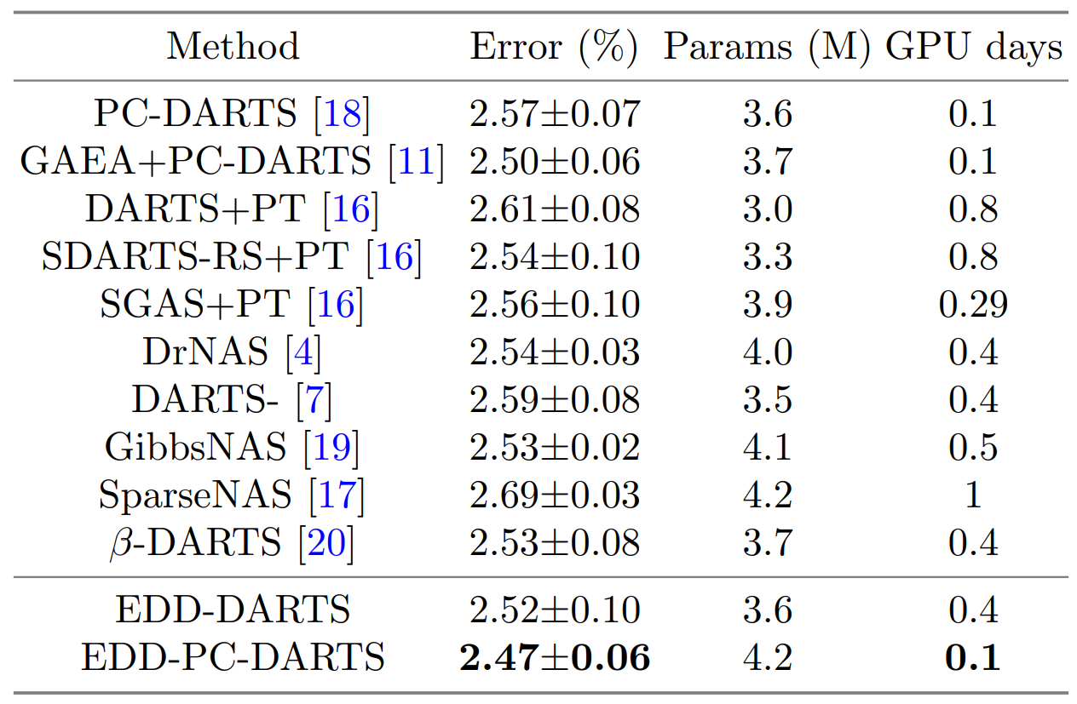
Experimental Results

Slide 20
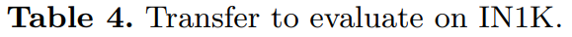
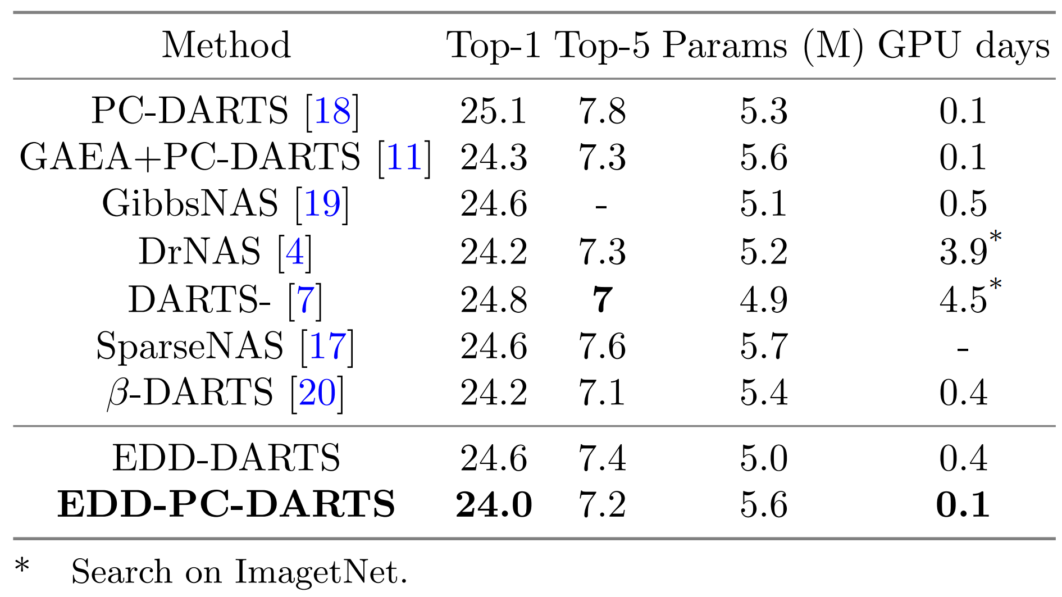
Experimental Results

Slide 21
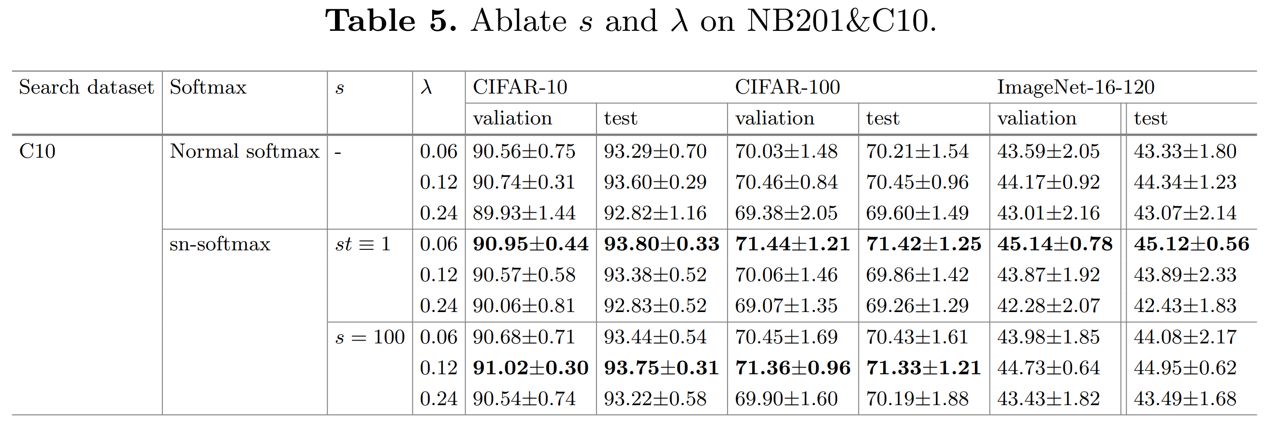
Experimental Results

Slide 22
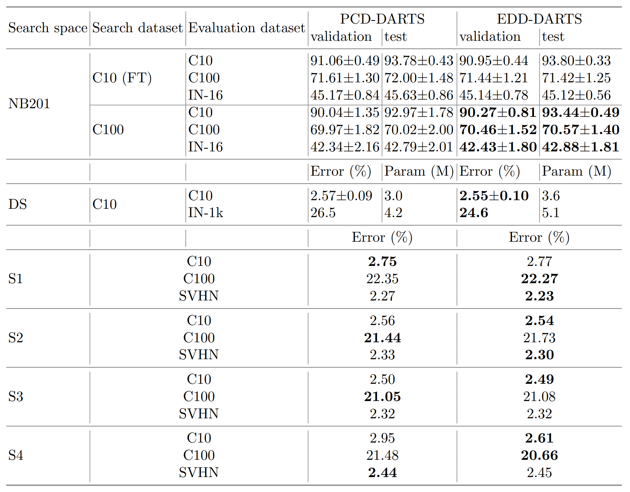
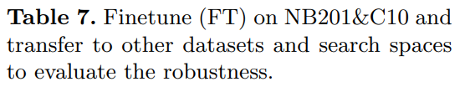
Experimental Results

Slide 23
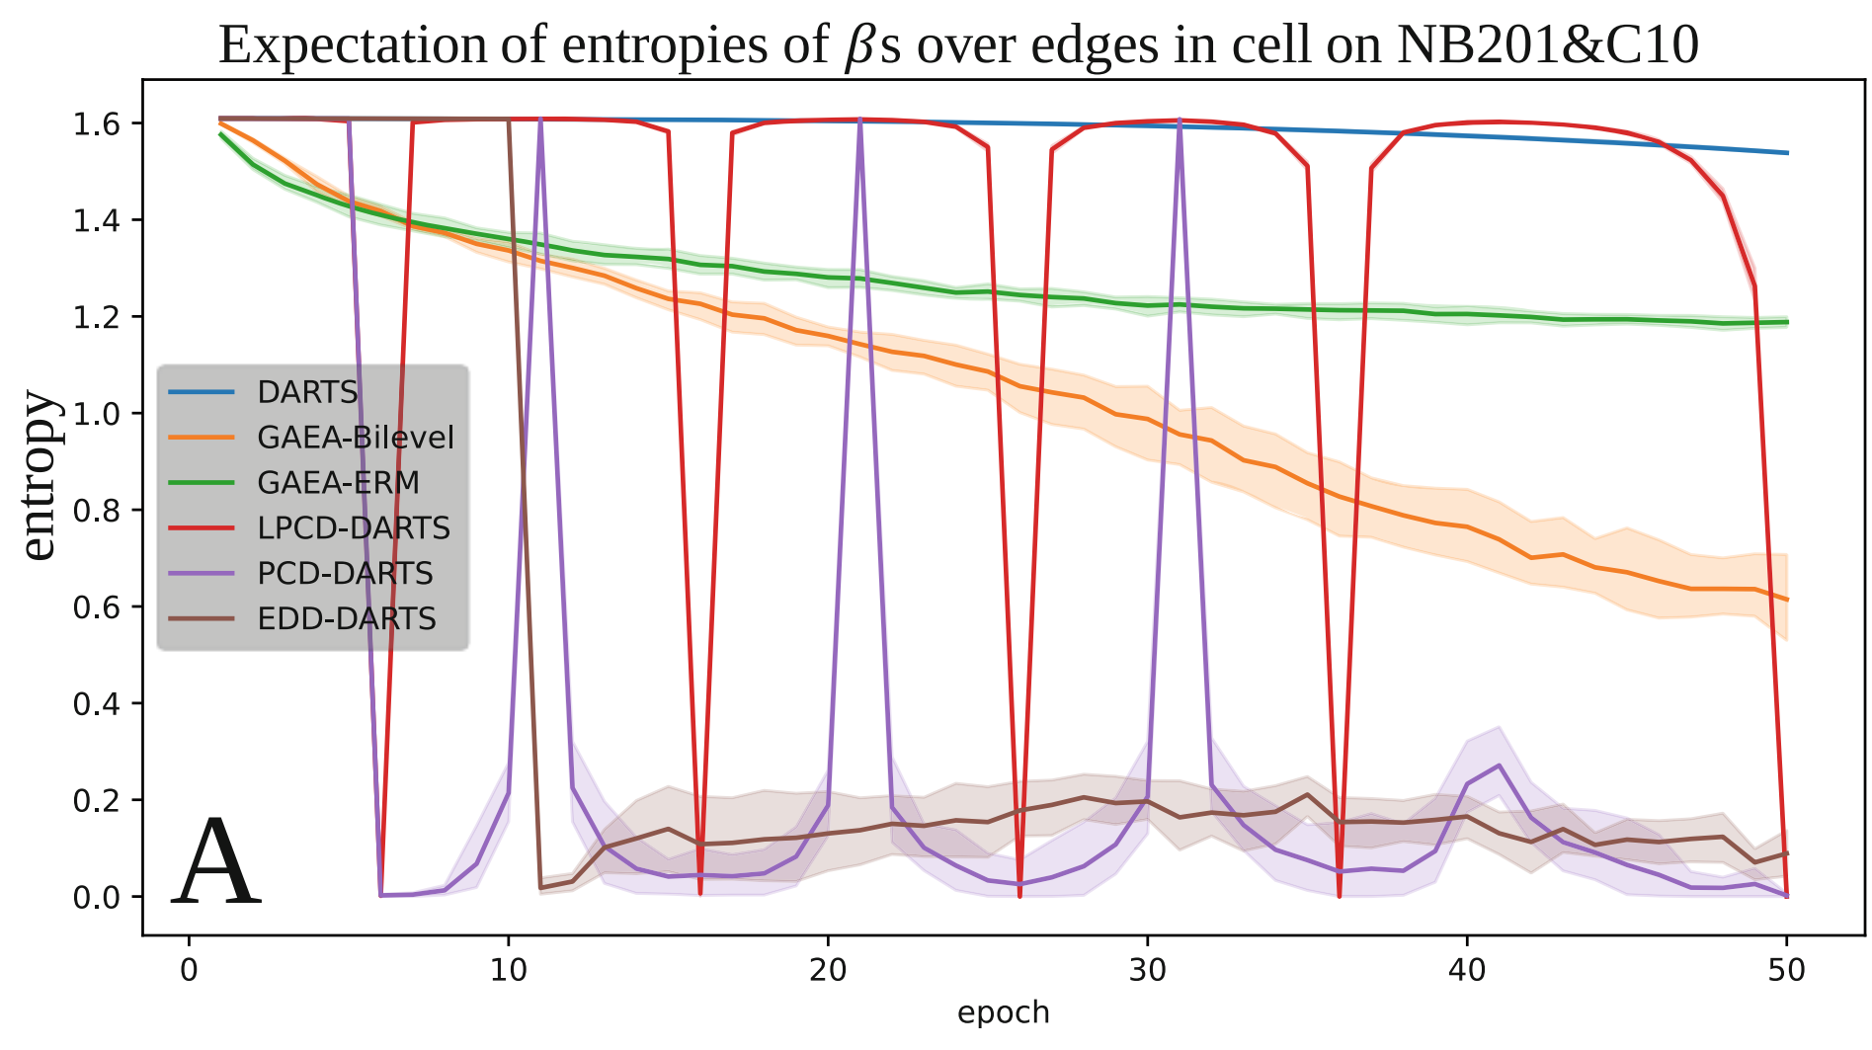
Experimental Results

Slide 24
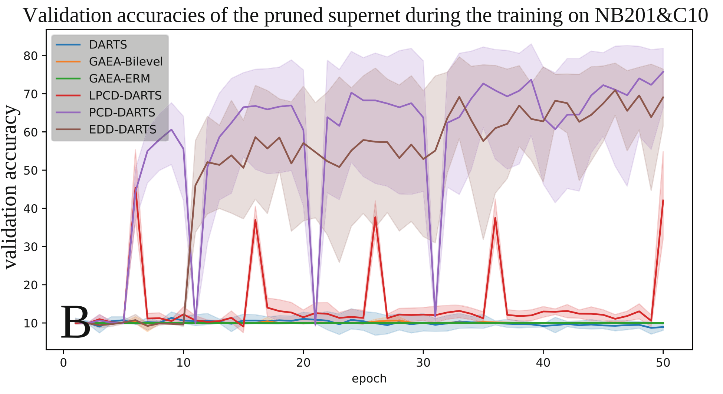
Experimental Results

Slide 25
Outline
Sparse-noisy Softmax
Exponential Temperature Schedule
Entropy-based Adaptive Scheme
Experimental Results
Conclusion
Future Works

Slide 26
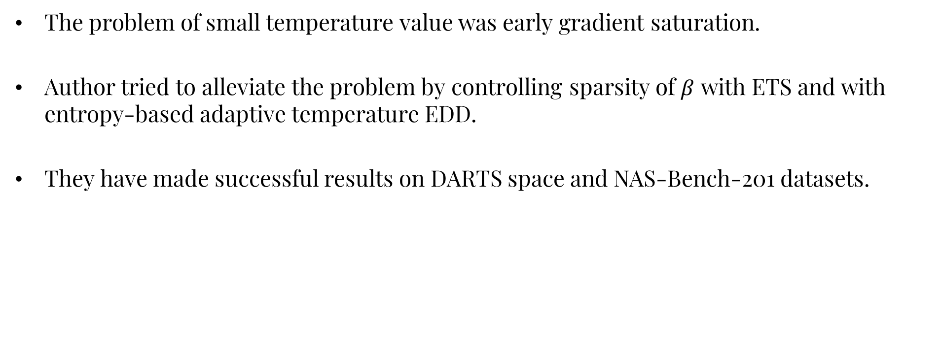
Conclusion
The problem of small temperature value was early gradient saturation.
Author tried to alleviate the problem by controlling sparsity of $β$ with ETS and with entropy-based adaptive temperature EDD.
They have made successful results on DARTS space and NAS-Bench-201 datasets.

Slide 27
Outline
Sparse-noisy Softmax
Exponential Temperature Schedule
Entropy-based Adaptive Scheme
Experimental Results
Conclusion
Future Works

Slide 28
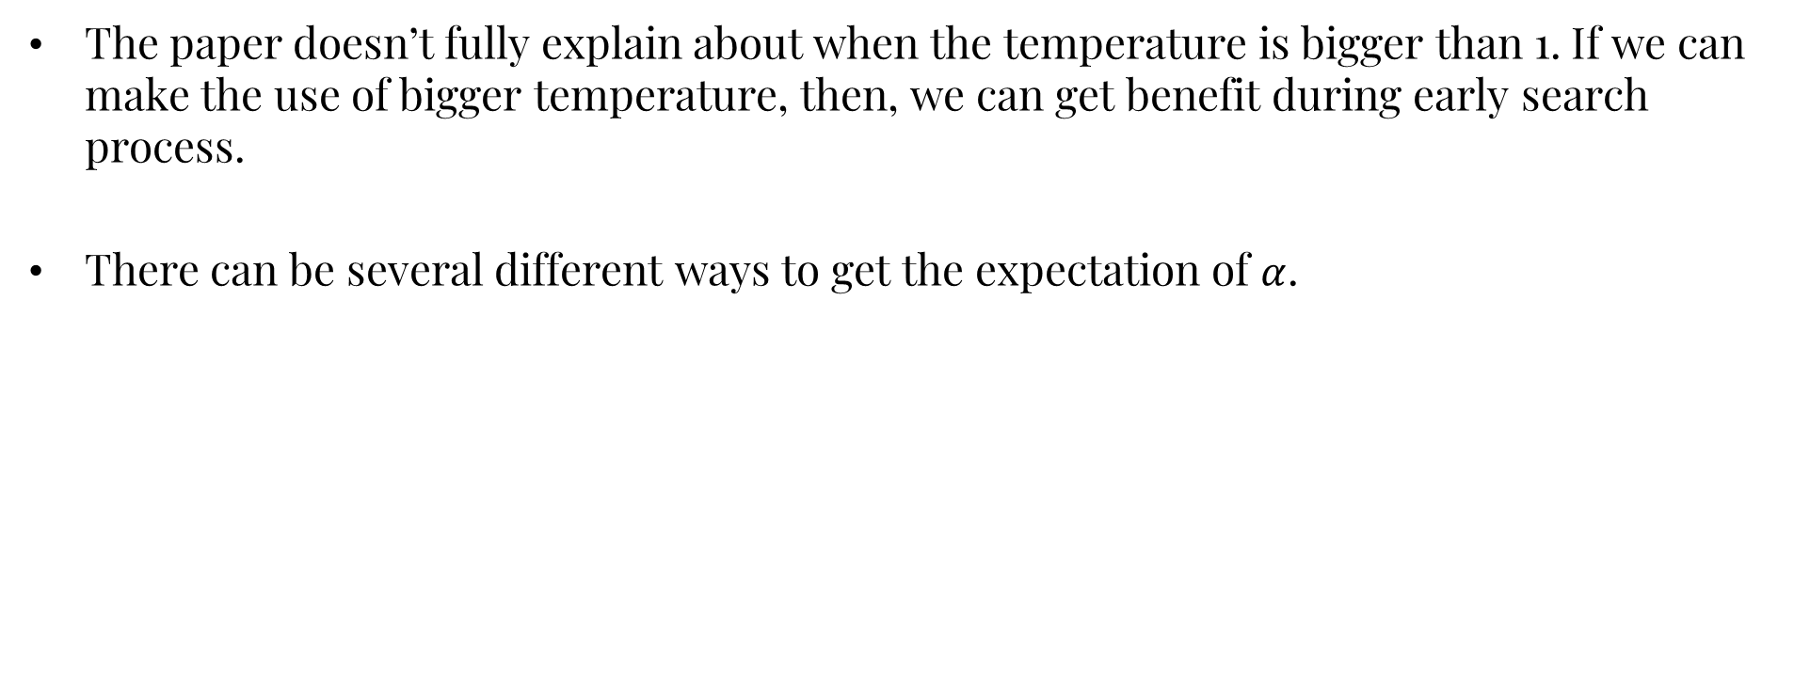
Future Works
The paper doesn’t fully explain about when the temperature is bigger than 1. If we can make the use of bigger temperature, then, we can get benefit during early search process.
There can be several different ways to get the expectation of $α$.

Slide 29
References
Jiuling Zhang, Zhiming Ding, “Small Temperature is All You Need for Differentiable Architecture Search”, PAKDD 2023: Advanced in Knowledge Discovery and Datamining, pp. 303-315, https://link.springer.com/chapter/10.1007/978-3-031-33374-3_24
“DrNAS: Dirichlet Neural Architecture Search”, ICLR, 2021, https://github.com/xiangning-chen/DrNAS/tree/master/DARTS-space
“Search in DARTS search space” – Neural Network Intelligence https://nni.readthedocs.io/en/latest/tutorials/darts.html

Slide 30
Thank you!
Q & A

Slide 31
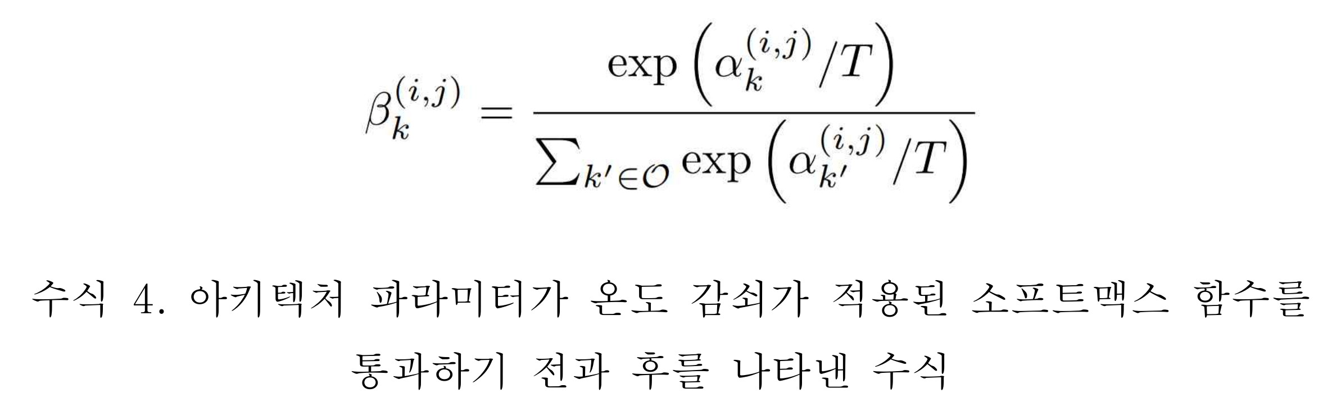
Sparse-noisy Softmax
(1)

Slide 32

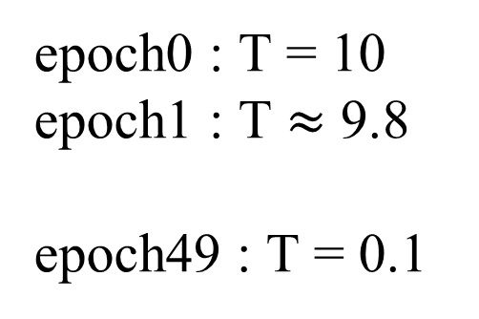
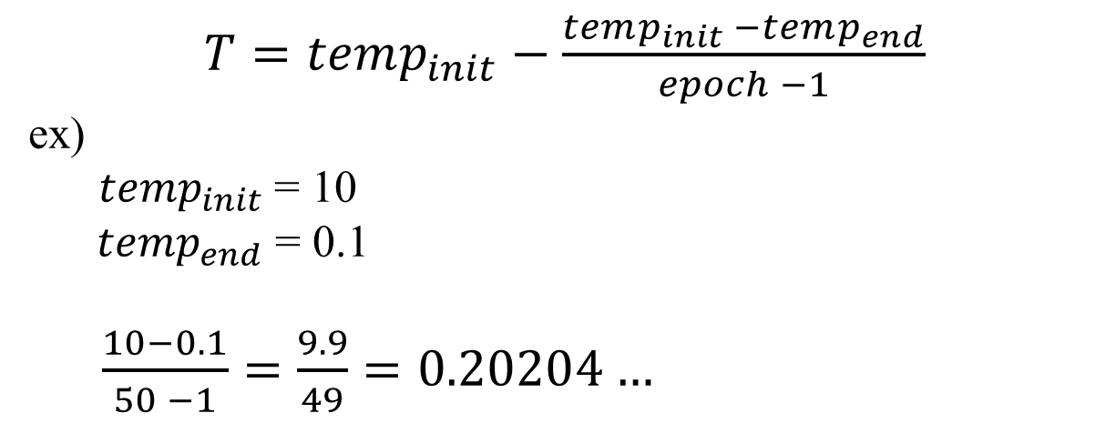
4. 온도 감쇠 미분가능 아키텍처 검색(TD-DARTS) (5/7)
$T=temp_{init}−\frac{temp_{init} −temp_{end}}{epoch −1}$
ex)
$temp_{init}$= 10
$temp_{end}$ = 0.1
$\frac{10−0.1}{50 −1}=\frac{9.9}{49}=0.20204…$
epoch0 : T = 10
epoch1 : T $≈$ 9.8
epoch49 : T = 0.1
32
Notes:
32

Slide 33
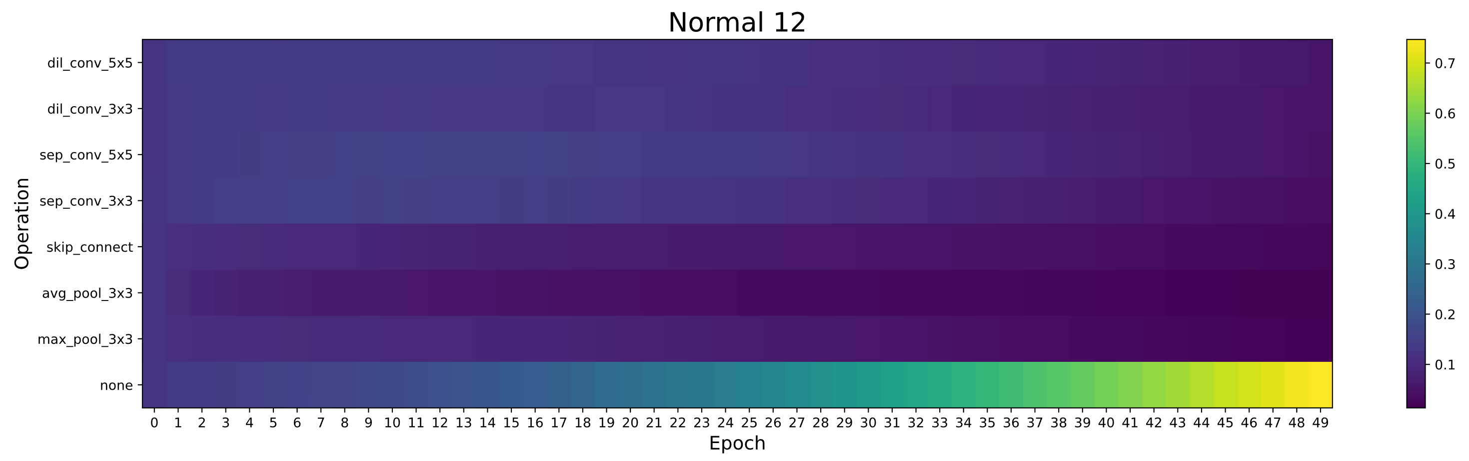
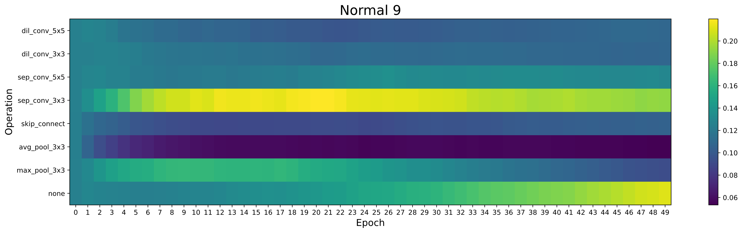
Sparse-noisy Softmax

Slide 34
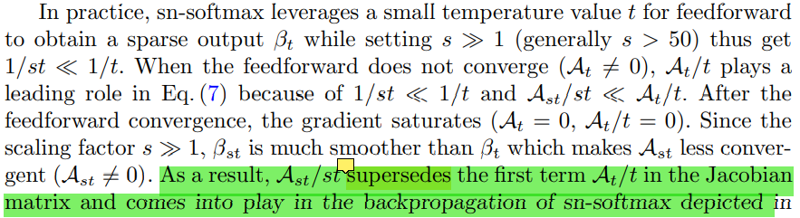
Sparse-noisy Softmax
(4)
(5)

